Slide 1


http://www.comp.nus.edu.sg/~cs1010/
UNIT 17
Recursion

Slide 2

PROGRAMMING METHODOLOGY (PHƯƠNG PHÁP LẬP TRÌNH)
UNIT 17: Recursion

Slide 3
Acknowledgement
The contents of these slides have origin from School of Computing, National University of Singapore.
We greatly appreciate support from Mr. Aaron Tan Tuck Choy for kindly sharing these materials.

Slide 4
Policies for students
These contents are only used for students PERSONALLY.
Students are NOT allowed to modify or deliver these contents to anywhere or anyone for any purpose.

Slide 5
Recording of modifications
Currently, there are no modification on these contents.

Slide 6
Unit 17: Recursion
Objectives:
Understand the nature of recursion
Learn to write recursive functions
Comparing recursive codes with iterative codes
Reference:
Chapter 8, Lesson 8.6
Useful link:
http://visualgo.net/recursion.html

Slide 7
Unit 17: Recursion
Introduction
Two Simple Classic Examples
2.1 Demo #1: Factorial
2.2 Demo #2: Fibonacci
Gist of Recursion
Thinking Recursively
4.1 Think: Sum of Squares
4.2 Demo #3: Counting Occurrences
Auxiliary Function
Types of Recursion
Tracing Recursive Codes
Recursion versus Iteration
Towers of Hanoi (in separate file)

Slide 8
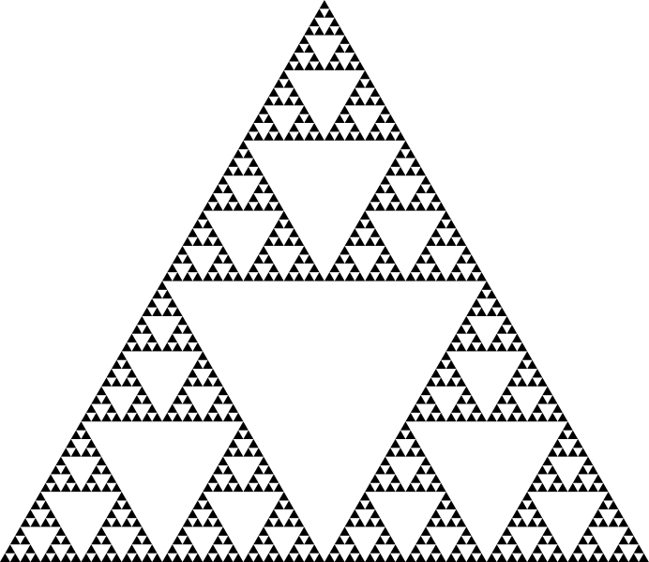
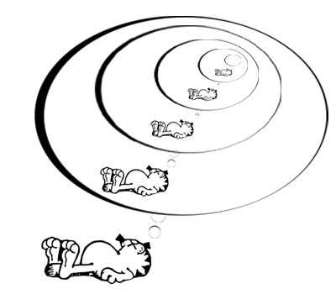
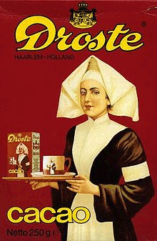
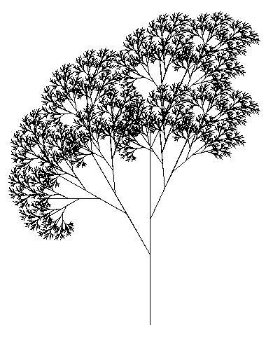
1. Introduction (1/3)
RECURSION
A central idea in CS.
Some examples of recursion (inside and outside CS):
Garfield dreaming recursively.
Sierpinksi triangle
Droste effect
Recursive tree

Slide 9
1. Introduction (2/3)
RECURSION
A central idea in CS.
Definitions based on recursion:
Dictionary entry:
Recursion: See recursion.
Recursive definitions:
A person is a descendant of another if
the former is the latter’s child, or
the former is one of the descendants of the latter’s child.
A list of numbers is
a number, or
a number followed by a list of numbers.
To understand recursion, you must first understand recursion.
Recursive acronyms:
GNU = GNU’s Not Unix
PHP = PHP: Hypertext Preprocessor

Slide 10
1. Introduction (3/3)
There is NO new syntax needed for recursion.
Recursion is a form of (algorithm) design; it is a problem-solving technique for divide-and-conquer paradigm
Very important paradigm – many CS problems solved using it
Recursion is:
A method where the solution to a problem depends on solutions to smaller instances of the SAME problem.

Slide 11
2. Two Simple Classic Examples
From these two examples, you will see how a recursive algorithm works
Winding phase
Invoking/calling ‘itself’ to solve smaller or simpler instance(s) of a problem …
… and then building up the answer(s) of the simpler instance(s).
Unwinding phase

Slide 12
2.1 Demo #1: Factorial (1/3)
n! = n × (n – 1) × (n – 2) × … × 2 × 1
Iterative code (version 1):
// Pre-cond: n >= 0
int factorial_iter1(int n) {
int ans = 1, i;
for (i=2; i<=n; i++) {
ans *= i;
}
return ans;
}
Iterative code (version 2):
// Pre-cond: n >= 0
int factorial_iter2(int n) {
int ans = 1;
while (n > 1) {
ans *= n;
n--;
}
return ans;
}
Unit17_Factorial.c

Slide 13
2.1 Demo #1: Factorial (2/3)
Recurrence relation:
n! = n × (n – 1)!
0! = 1
n! = n × (n – 1) × (n – 2) × … × 2 × 1
Doing it the recursive way?
// Pre-cond: n >= 0
int factorial(int n) {
if (n == 0)
return 1;
else
return n*factorial(n-1);
}
No loop!
But calling itself (recursively) brings out repetition.
Note: All the three versions work only for n < 13, due to the range of values permissible for type int. This is the limitation of the data type, not a limitation of the problem-solving model.

Slide 14
2.1 Demo #1: Factorial (3/3)
int f(int n) {
if (n == 0)
return 1;
else
return n * f(n-1);
}
Trace factorial(3). For simplicity, we write f(3).
Winding:
Trace tree:
f(3): Since 3 ≠ 0, call 3 * f(2)
f(2): Since 2 ≠ 0, call 2 * f(1)
f(1): Since 1 ≠ 0, call 1 * f(0)
f(0): Since 0 == 0, …
f(3)
6
3 *
f(2)
2
Unwinding:
2 *
f(1)
1
f(0): Return 1
f(1): Return 1 * f(0) = 1 * 1 = 1
f(2): Return 2 * f(1) = 2 * 1 = 2
f(3): Return 3 * f(2) = 3 * 2 = 6
1 *
f(0)
1

Slide 15

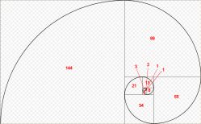
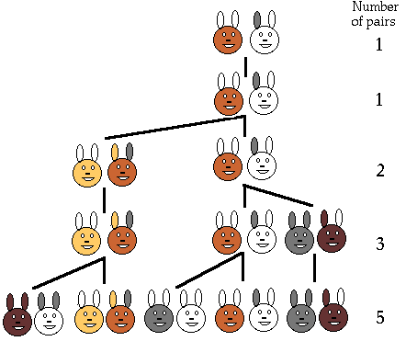
2.2 Demo #2: Fibonacci (1/4)
The Fibonacci series models the rabbit population each time they mate:
1, 1, 2, 3, 5, 8, 13, 21, …
The modern version is:
0, 1, 1, 2, 3, 5, 8, 13, 21, …
Fibonacci numbers are found in nature (sea-shells, sunflowers, etc)
http://www.maths.surrey.ac.uk/hosted-sites/R.Knott/Fibonacci/fibnat.html

Slide 16
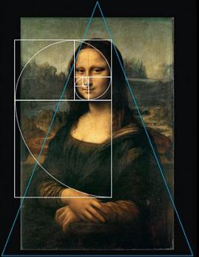

2.2 Demo #2: Fibonacci (2/4)
Fibonacci numbers are found in nature (sea-shells, sunflowers, etc)
http://www.maths.surrey.ac.uk/hosted-sites/R.Knott/Fibonacci/fibnat.html

Slide 17
2.2 Demo #2: Fibonacci (3/4)
0, 1, 1, 2, 3, 5, 8, 13, 21, …
Unit17_Fibonacci.c
Iterative code:
Recursive code:
// Pre-cond: n >= 0
int fib_iter(int n) {
int prev1 = 1,
prev2 = 0, sum;
if (n < 2)
return n;
for (; n>1; n--) {
sum = prev1 + prev2;
prev2 = prev1;
prev1 = sum;
}
return sum;
}
// Pre-cond: n >= 0
int fib(int n) {
if (n < 2)
return n;
else
return fib(n-1) + fib(n-2);
}
Recurrence relation:
f_{n} = f_{n-1} + f_{n-2} n ≥ 2
f₀ = 0
f₁ = 1

Slide 18
2.2 Fibonacci (4/4)
int fib(int n) {
if (n < 2)
return n;
else
return fib(n-1) + fib(n-2);
}
fib(n) makes 2 recursive calls: fib(n-1) and fib(n-2)
Trace tree (or call tree) for fib(5)
Winding
5
Unwinding
fib(5)
3
2
fib(4)
fib(3)
2
1
1
1
fib(3)
fib(2)
fib(2)
fib(1)
1
1
1
0
1
0
fib(2)
fib(1)
fib(1)
fib(0)
fib(1)
fib(0)
1
0
fib(1)
fib(0)

Slide 19


3. Gist of Recursion (1/6)
Iteration vs Recursion: How to compute factorial(3)?
You, do f(2) for me. I’ll return 3 * your answer to my boss.
Recursion man
You, do f(1) for me. I’ll return 2 * your answer to my boss.
Iteration man
I do f(3) all by myself…return 6 to my boss.
You, do f(0) for me. I’ll return 1 * your answer to my boss.
f(3)
f(2)
I will do f(0) all by myself, and return 1 to my boss.
f(3)
f(1)
f(0)

Slide 20
3. Gist of Recursion (2/6)
Problems that lend themselves to a recursive solution have the following characteristics:
One or more simple cases (also called base cases or anchor cases) of the problem have a straightforward, non-recursive solution
The other cases can be redefined in terms of problems that are smaller, i.e. closer to the simple cases
By applying this redefinition process every time the recursive function is called, eventually the problem is reduced entirely to simple cases, which are relatively easy to solve
The solutions of the smaller problems are combined to obtain the solution of the original problem

Slide 21
3. Gist of Recursion (3/6)
To write a recursive function:
Identify the base case(s) of the relation
Identify the recurrence relation
// Pre-cond: n >= 0
int factorial(int n) {
if (n == 0)
return 1;
else
return n * factorial(n-1);
}
// Pre-cond: n >= 0
int fib(int n) {
if (n < 2)
return n;
else
return fib(n-1) + fib(n-2);
}

Slide 22
3. Gist of Recursion (4/6)
Always check for base case(s) first
What if you omit base case(s)?
Do not write redundant base cases
int factorial(int n) {
if (n == 0)
return 1;
else if (n == 1)
return 1;
else if (n == 2)
return 2;
else if (n == 3)
return 6;
else
return n * factorial(n-1);
}
redundant

Slide 23
3. Gist of Recursion (5/6)
When a function is called, an activation record (or frame) is created by the system.
Each activation record stores the local parameters and variables of the function and its return address.
Such records reside in the memory called stack.
Stack is also known as LIFO (last-in-first-out) structure
A recursive function can potentially create many activation records
Winding: each recursive call creates a separate record
Unwinding: each return to the caller erases its associated record

Slide 24
3. Gist of Recursion (6/6)
int f(int n) {
if (n == 0) return 1;
else return n * f(n-1);
}
Example: factorial(3)
n
0
n
n
1
n
1
1
1
n
n
n
n
1
2
2
2
2
n
n
n
n
n
3
3
3
3
3
f(3)
f(2)
f(1)
f(0)
n
2
n
n
2
3
3
6

Slide 25

4. Thinking Recursively
It is apparent that to do recursion you need to think “recursively”:
Breaking a problem into simpler problems that have identical form
Is there only one way of breaking a problem into simpler problems?

Slide 26
4.1 Think: Sum of Squares (1/5)
Given 2 positive integers x and y, where x ≤ y, compute
sumSq(x,y) = x² + (x+1) ² + … + (y-1) ² + y²
For example
sumSq(5,10) = 5² + 6² + 7² + 8² + 9² + 10² = 355
How do you break this problem into smaller problems?
How many ways can it be done?
We are going to show 3 versions
See Unit17_SumSquares.c

Slide 27
4.1 Think: Sum of Squares (2/5)
Version 1: ‘going up’
int sumSq1(int x, int y) {
if (x == y) return x * x;
else return x * x + sumSq1(x+1, y);
}
Version 2: ‘going down’
int sumSq2(int x, int y) {
if (x == y) return y * y;
else return y * y + sumSq2(x, y-1);
}

Slide 28
4.1 Think: Sum of Squares (3/5)
Version 3: ‘combining two half-solutions’
int sumSq3(int x, int y) {
int mid; // middle value
if (x == y)
return x * x;
else {
mid = (x + y)/2;
return sumSq3(x, mid) + sumSq3(mid+1, y);
}
}

Slide 29
4.1 Think: Sum of Squares (4/5)
Trace trees
355
355
sumSq1(5,10)
sumSq2(5,10)
25
+
330
100
+
255
sumSq1(6,10)
sumSq2(5,9)
36
+
294
81
+
174
sumSq1(7,10)
sumSq2(5,8)
49
+
245
64
+
110
sumSq1(8,10)
sumSq2(5,7)
64
+
181
49
+
61
sumSq1(9,10)
sumSq2(5,6)
81
+
100
36
+
25
sumSq1(10,10)
sumSq2(5,5)
100
25

Slide 30
4.1 Think: Sum of Squares (5/5)
Trace tree
355
sumSq3(5,10)
110
245
sumSq3(5,7)
sumSq3(8,10)
61
49
145
100
sumSq3(5,6)
sumSq3(7,7)
sumSq3(8,9)
sumSq3(10,10)
25
36
49
64
81
100
sumSq3(5,5)
sumSq3(6,6)
sumSq3(8,8)
sumSq3(9,9)
25
36
64
81

Slide 31
4.2 Demo #3: Counting Occurrences (1/4)
Given an array
int list[ ] = { 9, -2, 1, 7, 3, 9, -5, 7, 2, 1, 7, -2, 0, 8, -3 }
We want
countValue(7, list, 15)
to return 3 (the number of times 7 appears in the 15 elements of list.

Slide 32
4.2 Demo #3: Counting Occurrences (2/4)
Iterative code:
Unit17_CountValue.c
int countValue_iter(int value, int arr[], int size) {
int count = 0, i;
for (i=0; i<size; i++)
if (value == arr[i])
count++;
return count;
}

Slide 33

4.2 Demo #3: Counting Occurrences (3/4)
To get countValue(7, list, 15) to return 3.
Recursive thinking goes…
9
-2
1
7
3
9
-5
7
2
1
7
-2
0
8
-3
… and get someone to count the 7 in this smaller problem, …
If I handle the last element myself, …
… then, depending on whether the last element is 7 or not, my answer is either his answer or his answer plus 1!

Slide 34
4.2 Demo #3: Counting Occurrences (4/4)
Recursive code:
Unit17_CountValue.c
int countValue(int value, int arr[], int size) {
if (size == 0)
return 0;
else
return (value == arr[size-1]) +
countValue(value, arr, size-1);
}
Note: The second return statement is equivalent to the following (why?):
if (value == arr[size-1])
return 1 + countValue(value, arr, size-1);
else
return countValue(value, arr, size-1);

Slide 35
5. Auxiliary Function (1/3)
Sometimes, auxiliary functions are needed to implement recursion. Eg: Refer to Demo #3 Counting Occurrences.
If the function handles the first element instead of the last, it could be re-written as follows:
int countValue(int value, int arr[],
int start, int size) {
if (start == size)
return 0;
else
return (value == arr[start]) +
countValue(value, arr, start+1, size);
}

Slide 36
5. Auxiliary Function (2/3)
However, doing so means that the calling function has to change the call from:
countValue(value, list, ARRAY_SIZE)
to:
countValue(value, list, 0, ARRAY_SIZE)
The additional parameter 0 seems like a redundant data from the caller’s point of view.

Slide 37
5. Auxiliary Function (3/3)
Solution: Keep the calling part as:
countValue(value, list, ARRAY_SIZE)
Rename the original countValue() function to countValue_recur(). The recursive call inside should also be similarly renamed.
Add a new function countValue() to act as a driver function, as follows:
int countValue(int value, int arr[], int size) {
return countValue_recur(value, arr, 0, size);
}
See program Unit17_CountValue_Auxiliary.c

Slide 38
6. Types of Recursion
Besides direct recursion (function A calls itself), there could be mutual or indirect recursion (we do not cover these in CS1010)
Examples: Function A calls function B, which calls function A; or function X calls function Y, which calls function Z, which calls function X.
Note that it is not typical to write a recursive main() function.
One type of recursion is known as tail recursion.
Not covered in CS1010

Slide 39
7. Tracing Recursive Codes
Beginners usually rely on tracing to understand the sequence of recursive calls and the passing back of results.
However, tracing a recursive code is tedious, especially for non-tail-recursive codes. The trace tree could be huge (example: fibonacci).
If you find that tracing is needed to aid your understanding, start tracing with small problem sizes, then gradually see the relationship between the successive calls.
Students should grow out of tracing habit and understand recursion by examining the relationship between the problem and its immediate subproblem(s).

Slide 40
8. Recursion versus Iteration (1/2)
Iteration can be more efficient
Replaces function calls with looping
Less memory is used (no activation record for each call)
Some good compilers are able to transform a tail-recursion code into an iterative code.
General guideline: If a problem can be done easily with iteration, then do it with iteration.
For example, Fibonacci can be coded with iteration or recursion, but the recursive version is very inefficient (large call tree due to duplicate computations), so use iteration instead.

Slide 41
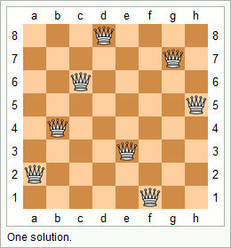
8. Recursion versus Iteration (2/2)
Many problems are more naturally solved with recursion, which can provide elegant solution.
Tower of Hanoi
Mergesort (to be covered in CS1020)
The N Queens problem
Conclusion: choice depends on problem and the solution context. In general, use recursion if …
A recursive solution is natural and easy to understand.
A recursive solution does not result in excessive duplicate computation.
The equivalent iterative solution is too complex.

Slide 42
9. Tower Of Hanoi
In a separate Powerpoint file.

Slide 43
Summary
In this unit, you have learned about
Recursion as a design strategy
The components of a recursive code
Differences between Recursion and Iteration

Slide 44
End of File

